Slide 1

BLG 411E SOFTWARE ENGINEERING
Week 1
Introduction – Software Projects

Slide 2
Course - Introduction
BLG411E – Software Engineering
İTÜ Credits : 3-0-0
ECTS Credits : 7,5
Course Web Site : www.ninova.itu.edu.tr
Lecture notes, announcements, report templates and examples, tools, etc.
2017-2018 Fall Semester
 | CRN13329 | CRN13330
Instructor | Assoc.Prof.Dr.A.Cüneyd TANTUĞ www.tantug.com | Asst.Prof.Dr. Ayse TOSUN web.itu.edu.tr/~tosunay
Office | 3309 | 2220
Office Hours | Thursday, 15:00-16:00 | Tuesday, 09:30-12:30
Teaching Assistant | R.A. Bilge Süheyla AKKOCA R.A. Müge Erel R.A. Beyza Eken

Slide 3


Course - Textbooks
Software Engineering:
A Practitioner’s Approach (SEPA)
Roger S. Pressman, 6th ed.
McGraw-Hill, 2005
Object-Oriented and Classical Software Engineering Stephen R. Schach, 8th ed.
McGraw-Hill, 2010

Slide 4
Course - Supplementaries
Other Books | Software Engineering Ian Sommerville., Addison Wesley, 2010 Yazılım Mühendisliği Erhan Sarıdoğan, 1st ed., Papatya Yayıncılık, 2004
Journals | IEEE Transactions on Software Engineering IEEE Software ACM Transactions on Software Engineering and Methodology Please click here for a larger list of journals.
Societies | The IEEE Computer Society
Other Links | The Software Engineering Institute

Slide 5
Course - Outline
Week | Date | Topic | Homeworks/Projects
1 | 12.09.2017 | Introduction – Software Projects and Scope (Ch.1)
2 | 19.09.2017 | Software Processes Models (Ch.2) | Project Charter
3 | 26.09.2017 | Agile Software Development | Revised Project Charter
4 | 3.10.2017 | Software Project Planning and Estimation(Ch. 9) - FLIPPED
5 | 10.10.2017 | Requirements Engineering (Ch.11)+ Recitation: JIRA | Project Plan
6 | 17.10.2017 | Requirements Analysis (Ch. 12- Ch.13)+ Recitation: ArgoUML
7 | 24.10.2017 | Software Architectures+ Recitation: NodeJS | Requirements Spec.
8 | FALL BREAK
9 | 7.11.2017 | Midterm
10 | 14.11.2017 | Software Design (Ch. 14-17)
11 | 21.11.2017 | Software Design (Ch. 14-17)+ Recitation: Hibernate, Log4J | Design Document
12 | 28.11.2017 | Implementation and Testing (Ch.14-15)
13 | 5.12.2017 | Implementation and Testing (Ch.14-15)+ Recitation: Junit, Mockito, Jmeter (Selenium)
14 | 12.12.2017 | Project Presentations | Test Report
15 | 19.12.2017 | Project Presentations

Slide 6
Course - Grading
Midterm Exam (x 1) | %25
Final Exam | %40
Project | %35
Total | %100
Tentative (subject to change)

Slide 7
Projects
Topics can be selected from this contest:
http://score-contest.org/2018/projects.php
Topics suggestions are allowed. But submitted project charters can be rejected and should be revised within one week.
Carried out in groups (4-5 students)
Has several phases: Requirements Specification, Design, Implementation, Test
Has several deliverables: SRS, SDS, Test Report, Source Code, Final Demo of the Product, Presentation
Some highlights:
Use of a version control system to track commit activities (e.g. BitBucket, GitHub) is mandatory.
Use of a unit testing tool (e.g. Junit, GoogleTest) is mandatory.
Use of automated testing through unit testing tools

Slide 8
Rules
RULE #1: PROJECT is a TEAM WORK!
RULE #2: EVERYONE needs to contribute to all phases of the project.
RULE #3: You need to report all your meetings with the customers (TAs) and confirm the needs before moving forward. Remember that customers change their minds too often!
RULE #4: At the end of the project, everyone will evaluate his/her team members’ performance and contribution to the project. This is going to be privately shared with the instructors only.
RULE #5: Inform us (me or TAs) early if you have any difficulties during the project regarding the topic, technologies or with your group members!
If a project member believes that some project members have not contributed the phase
Must submit a one-page summary for the phase, indicating how much he/she thinks each project member has contributed to the phase

Slide 9
Collaboration Policy
Plagiarism, cheating or copying other people’s work/documents/source code will be dealt with extreme intolerance.
Disciplinary actions will be applied immediately.

Slide 10

Introduction
Course Objectives
Software Projects
Stakeholders
Phases
Object Oriented Paradigm
Project Scope – How to begin a project?

Slide 11
What is Software Engineering?
Formal Definition
The application of a systematic, disciplined, quantifiable approach to the development, operation, and maintenance of software" [IEEE Standard, 610.12, 1990].

Slide 12
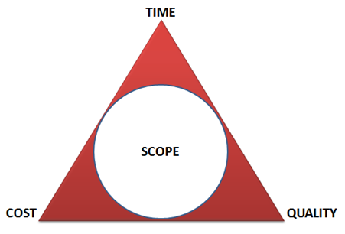
What is Software Engineering?
The study of systematic and effective processes and technologies for supporting software development and maintenance activities
Improve quality
Reduce costs
Deliver on-time

Slide 13
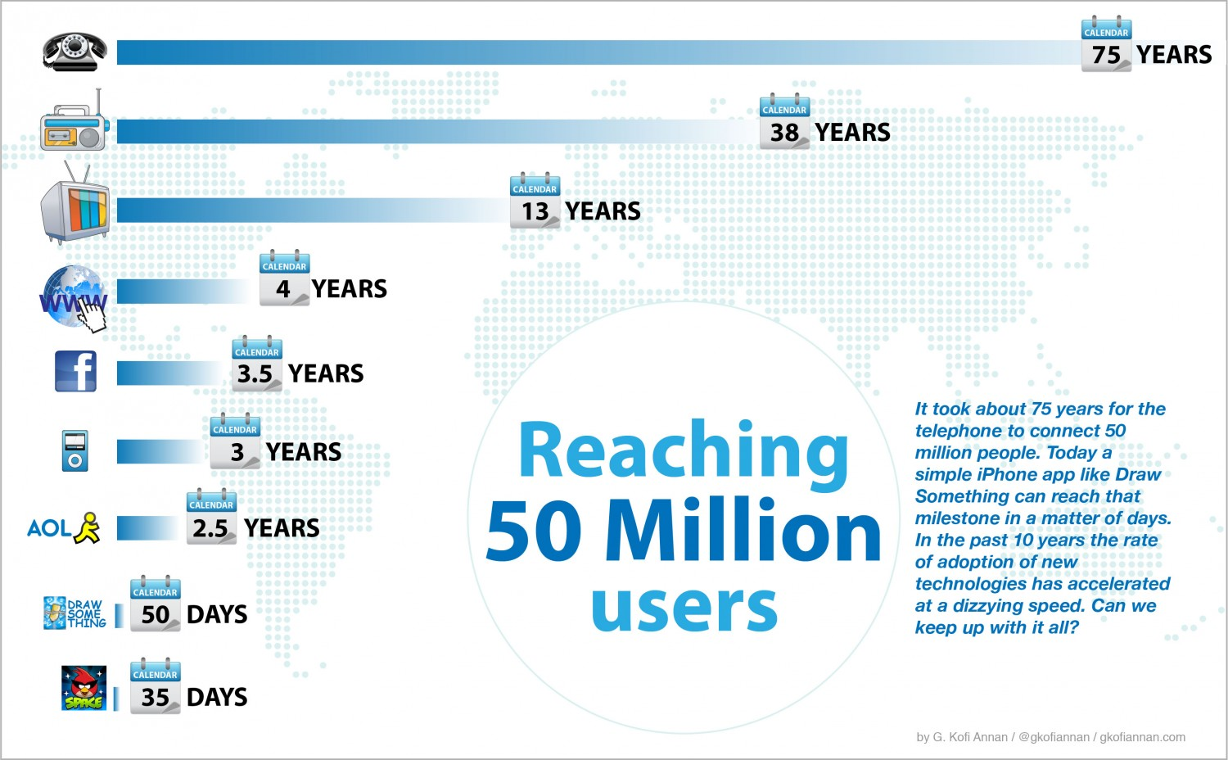
What’s the problem?
Software cannot be built fast enough to keep up with technology
Increasing need for high reliability software
Software is difficult to maintain
Difficult to estimate software costs and schedules
Too many projects fail

Slide 14
Software Disaster Examples - 1
Therac-25 (1985)
Cost: Three people dead, three people critically injured
Disaster: Canada’s Therac-25 radiation therapy machine malfunctioned and delivered lethal radiation doses to patients.
Cause: Because of a subtle bug called a race condition, a technician could accidentally configure Therac-25 so the electron beam would fire in high-power mode without the proper patient shielding.

Slide 15
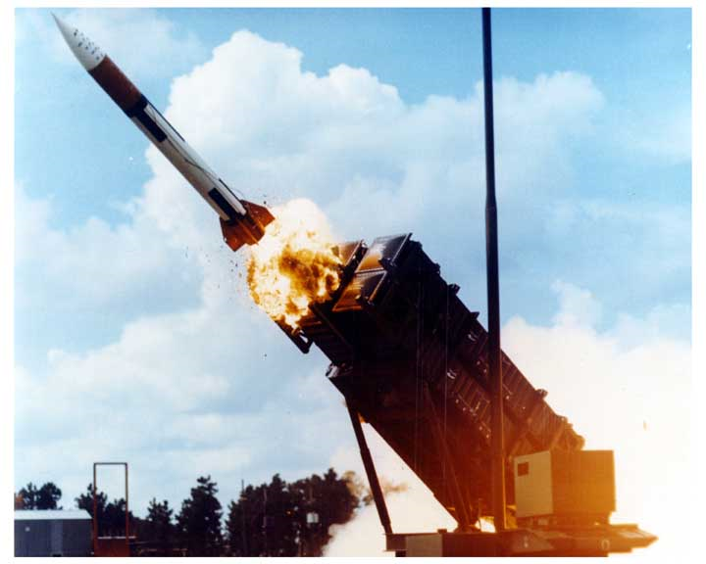
Software Disaster Examples -2
Patriot Missile (1991)
Cost: 28 soldiers dead, 100 injured
Disaster: During the first Gulf War, an American Patriot Missile system in Saudi Arabia failed to intercept an incoming Iraqi Scud missile. The missile destroyed an American Army barracks.
Cause: A software rounding error incorrectly calculated the time, causing the Patriot system to ignore the incoming Scud missile.

Slide 16

Software Disaster Examples - 3
Ariane 5 Rocket (1996)
Cost: $500 million
Disaster: Ariane 5, Europe’s newest unmanned rocket, was intentionally destroyed seconds after launch on its first flight. Also destroyed was its cargo of four scientific satellites to study how the Earth’s magnetic field interacts with solar winds.
Cause: Shutdown occurred when the guidance computer tried to convert the sideways rocket velocity from 64-bits to a 16-bit format. The number was too big, and an overflow error resulted. When the guidance system shut down, control passed to an identical redundant unit, which also failed because it was running the same algorithm.

Slide 17
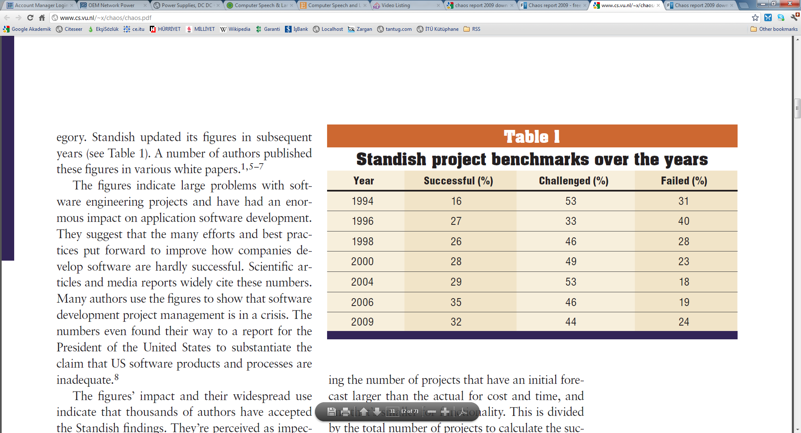
Standish Project Benchmarks over the years

Slide 18
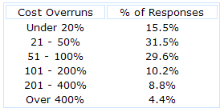
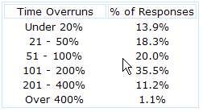
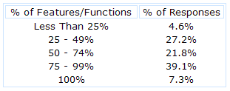
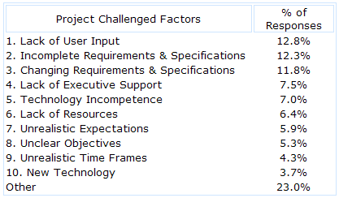
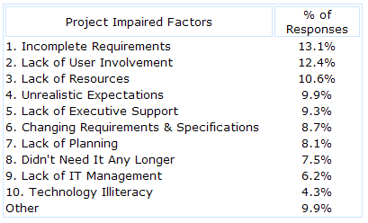
Overrunning??
Cost Overrun Data
Time Overrun Data
# of Feature Dropped
Factors Making SD Difficult
Factors Making SD Fail
Source : Standish Group

Slide 19
Why is software development so difficult?
Communication
Between customer and developer
Within development team
Project characteristics
Advancing technology
Changing requirements
Personnel characteristics
Personnel variability
High turnover
Facilities and resources
Management issues

Slide 20
Software Projects
Course Objectives
Software Projects
Phases
Stakeholders
Object Oriented Paradigm
Project Scope – How to begin a project?

Slide 21
Software Business
Today’s software development activities heavily rely on a project based approach.
A project can be seen as a series of planned activities packed within a scope. The scope of a software project consists of
Time: How much time do we need to complete the project.
Cost: How much effort needed to complete the project on time.
Quality: What primary and secondary features and functionalities should be present regarding the time and budget.
Software projects are generally carried out in phases (or stages) containing activities with the intent of better planning and management.

Slide 22
Software Development Stages
A very classical model called “waterfall” contains the following stages:
Requirements Phase
Analysis(specification) phase
Design phase
Implementation phase
Post-delivery maintenance
Retirement
Let’s work on a very basic example. Here are the questions you should ask for each stage of the software development for a mobile “alarm clock app”.

Slide 23
Requirements Phase
For the requirements phase, almost no technical detail should be considered in detail.
Explore the concept
Elicit the client’s requirements
Software is treated as a black box, we enlist the features that we wish to see
Do we have snooze operation?
Should we be able to give alias to alarms?
Is there going to be a soft alarm?
Should we be able to save multiple alarms?
Do we support periodic alarms?
Should we be able to assign custom alarm sounds?
… and many more

Slide 24
Analysis Phase
In the analysis phase, primary requirements on the technical issues are analyzed in a broad perspective.
Analyze the client’s requirements
Draw up the specification document
Draw up the software project management plan
“What the product is supposed to do”
In this phase for the alarm clock app we ask questions like
What is the maximum snooze repetition, how much should we wait in between?
Should the user be able to edit snooze time?
How should we increase the sound in soft alarm, should we use a different melody?
How should we list multiple alarms?
Should we disable the periodic alarm in holidays? How should we get the holiday information?
… and many more

Slide 25
Design Phase
In the design phase, most of the necessary decisions on the technical issues are made.
Architectural design, followed by
GUI design
Data and Functional design
In this phase for the alarm clock app we discuss questions like
Where should we save the alarm parameters (local db, file, cloud)?
How should the alarm list look like?
How should the single alarm edit screen look like?
What kind of mechanism should we use to trigger alarm? Thread- daemon process?
Should we use a list or an array for the alarm list?
How should we cache the holiday dates?

Slide 26
Rest of the Phases
Implementation phase
Coding
Unit testing
Integration
Acceptance testing
Post-delivery maintenance
Corrective maintenance
Perfective maintenance
Adaptive maintenance
Retirement

Slide 27
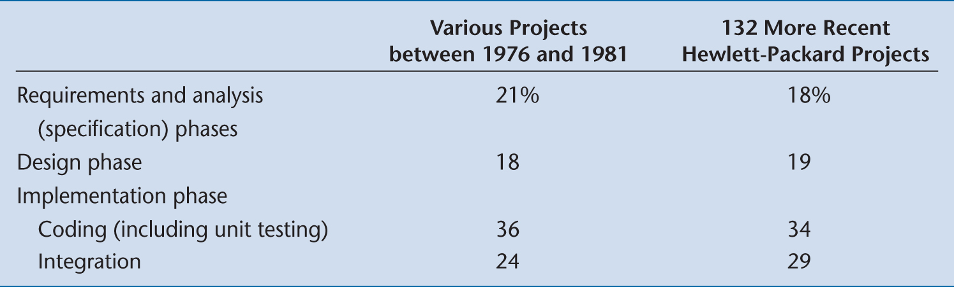
Cost of the Phases
Surprisingly, the costs of the classical phases have hardly changed

Slide 28
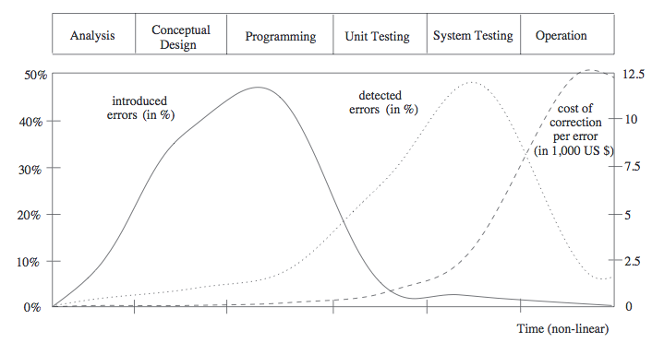
Cost of Faults
The cost of detecting and correcting a fault at each phase

Slide 29
Software Projects
When carrying out a software project, social aspects are generally more important than technical aspects.
Stakeholder: According to the Project Management Institute (PMI), “the term project stakeholder refers to, ‘an individual, group, or organization, who may affect, be affected by, or perceive itself to be affected by a decision, activity, or outcome of a project”

Slide 30
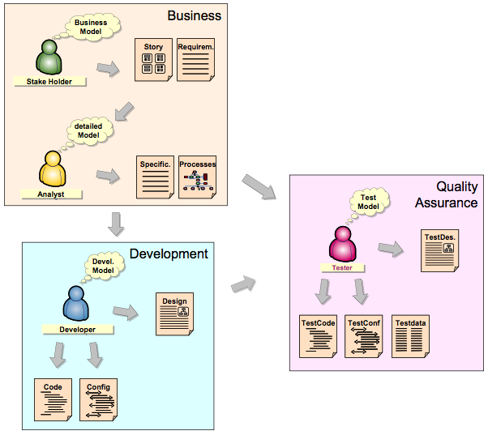
Software Project Stakeholders
The most common software project stakeholders are listed below.
User
Customer
Project Manager
Team Leader
Analyst – Requirements Eng.
Configuration Manager
Designer – Architect
UI-Web designer
Programmer
Tester
QA people
IT people
DevOps – Maintenance People

Slide 31
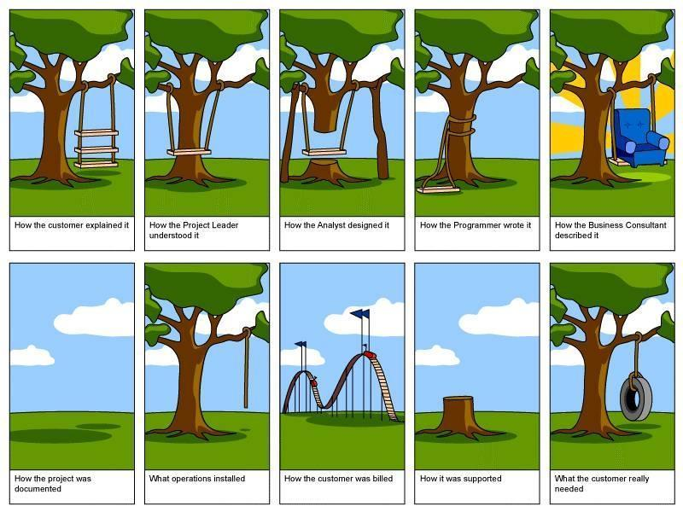
Communication Difficulties

Slide 32
Object Oriented Paradigm
Course Objectives
Software Projects
Phases
Stakeholders
Object Oriented Paradigm
Project Scope – How to begin a project?

Slide 33
Size of programs continues to grow...
Trivial: 1 month, 1 programmer, 500 LOC,
Intro programming assignments
Very small: 4 months, 1 programmer, 2000 LOC
Course project
Small: 2 years, 3 programmers, 50K LOC
Nuclear power plant, pace maker
Medium: 3 years, 10s of programmers, 100K LOC
Optimizing compiler
Large: 5 years, 100s of programmers, 1M LOC
MS Word, Excel
Very large: 10 years, 1000s of programmers, 10M LOC
Air traffic control,
Telecommunications, space shuttle
Unbelievable: ? years, ? programmers
W2K 35M LOC
Missile Defense System 100M LOC?
Skynet ???

Slide 34
The Object-Oriented Paradigm
The structured paradigm was successful initially
It started to fail with larger products (> 50,000 LOC)
Post-delivery maintenance problems (today, 70 to 80% of total effort)
Reason: Structured methods are
Action oriented (e.g., finite state machines, data flow diagrams); or
Data oriented (e.g., entity-relationship diagrams, Jackson’s method);
But not both

Slide 35
The Object-Oriented Paradigm
Both data and actions are of equal importance
Object:
A software component that incorporates both data and the actions that are performed on that data
Example:
Bank account
Data: account balance
Actions: deposit, withdraw, determine balance

Slide 36
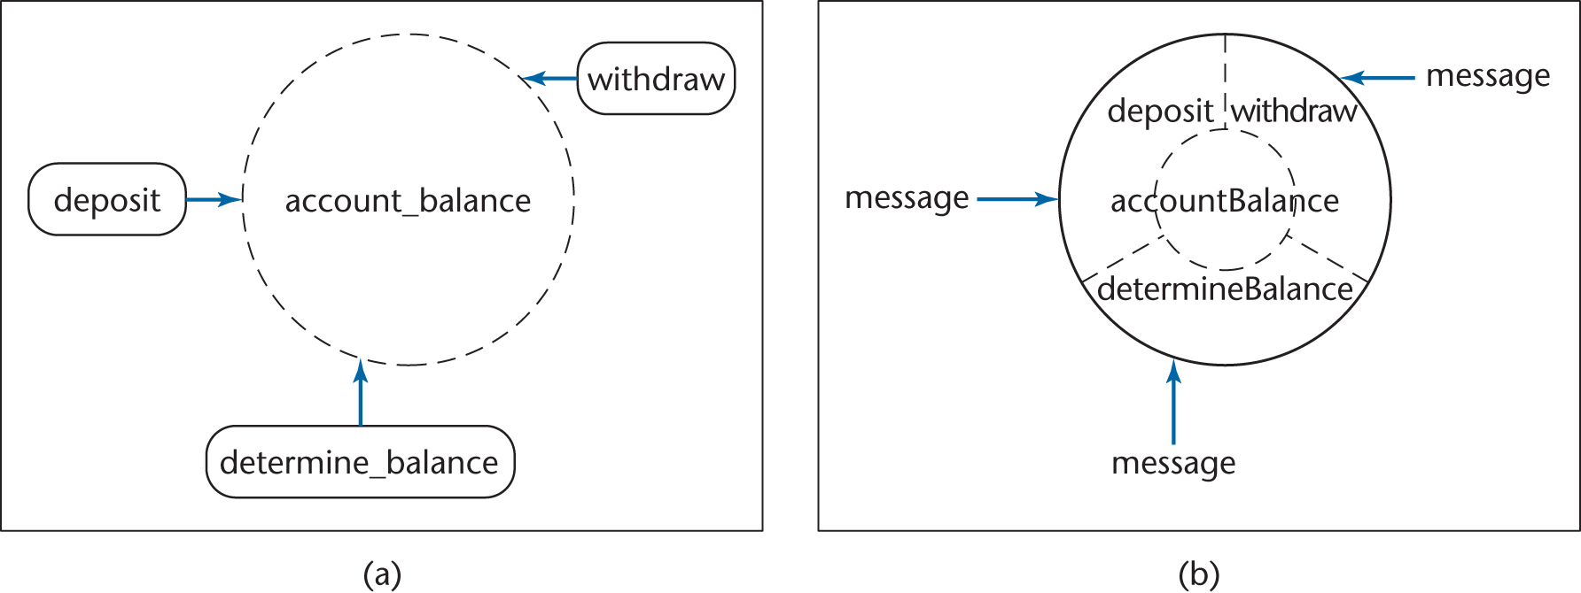
Structured vs Object-Oriented
Information hiding
Responsibility-driven design
Impact on maintenance, development
Figure 1.7

Slide 37
Information Hiding
In the object-oriented version
The solid line around accountBalance denotes that outside the object there is no knowledge of how accountBalance is implemented
In the classical version
All the modules have details of the implementation of account_balance

Slide 38
Strengths of the OO Paradigm
With information hiding, postdelivery maintenance is safer
The chances of a regression fault are reduced
Development is easier
Objects generally have physical counterparts
This simplifies modeling (a key aspect of the object-oriented paradigm)

Slide 39
Strengths of the Object-Oriented Paradigm
Well-designed objects are independent units
Everything that relates to the real-world item being modeled is in the corresponding object — encapsulation
Communication is by sending messages
This independence is enhanced by responsibility-driven design
Send flowers to your mother in Chicago
Call 1-800-flowers
Where is 1-800-flowers?
Which Chicago florist does the delivery?
Information hiding
Send a message to a method [action] of an object without knowing the internal structure of the object

Slide 40
Strengths of the Object-Oriented Paradigm
A classical product conceptually consists of a single unit (although it is implemented as a set of modules)
The object-oriented paradigm reduces complexity because the product generally consists of independent units
The object-oriented paradigm promotes reuse
Objects are independent entities

Slide 41
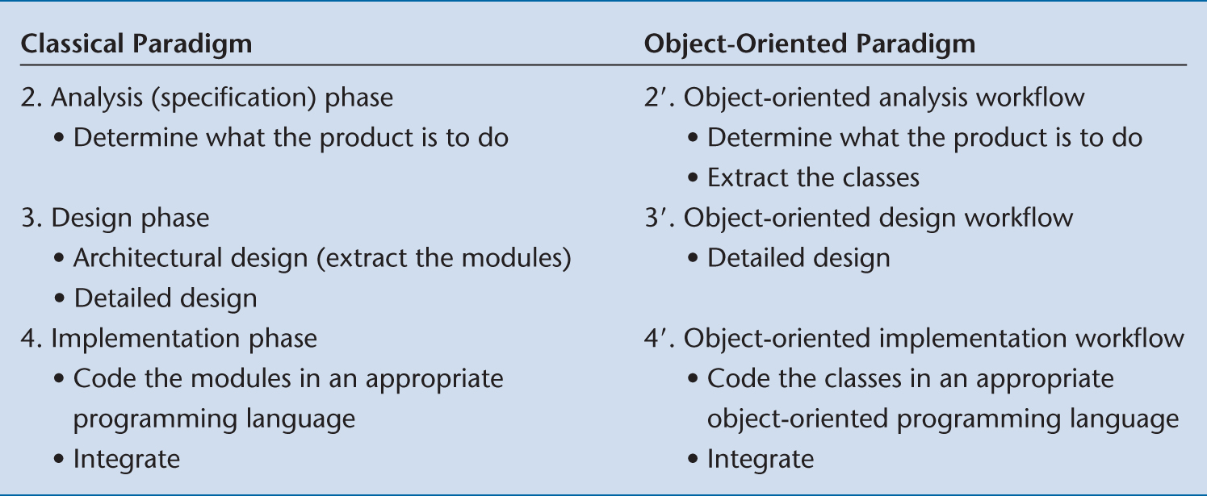
Differences in Phases
Objects enter here
Figure 1.9

Slide 42
Object-Oriented Paradigm
Modules (objects) are introduced as early as the object-oriented analysis workflow
This ensures a smooth transition from the analysis workflow to the design workflow
The objects are then coded during the implementation workflow
Again, the transition is smooth

Slide 43
Project Scope
Course Objectives
Software Projects
Phases
Stakeholders
Object Oriented Paradigm
Project Scope – How to begin a project?

Slide 44
Project Scope
The very first thing that’s done on a new project is the development of the project charter. That’s the document that authorizes you to do your work.
Project Charter tells everyone in the company why the project is needed, and gives you the authority you need to make it happen.
Then you identify stakeholders to figure out who is affected by the project and how to communicate with them

Slide 45
Project Charter
Even though may change from case to case, a project charter (sometimes called as a “one-pager”) typically includes the following items in a single page:
Project Description
Project Objectives and Outcomes
Assigned Project Manager and Staff
Summary Milestone Schedule
Preliminary Cost Estimation
Preliminary Risks

Slide 46
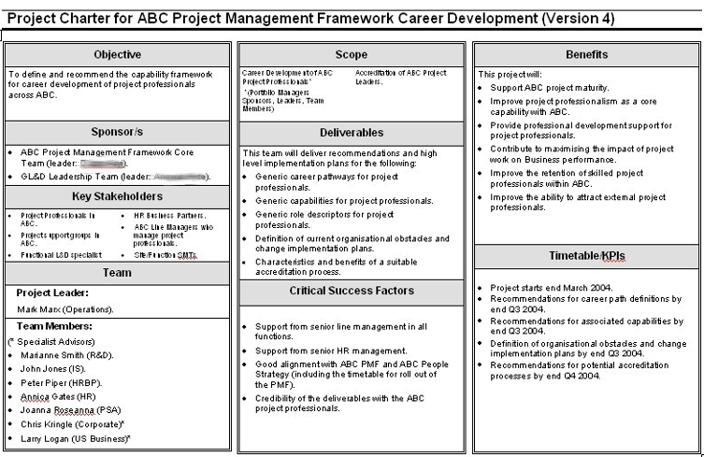
Project Charter

Slide 47
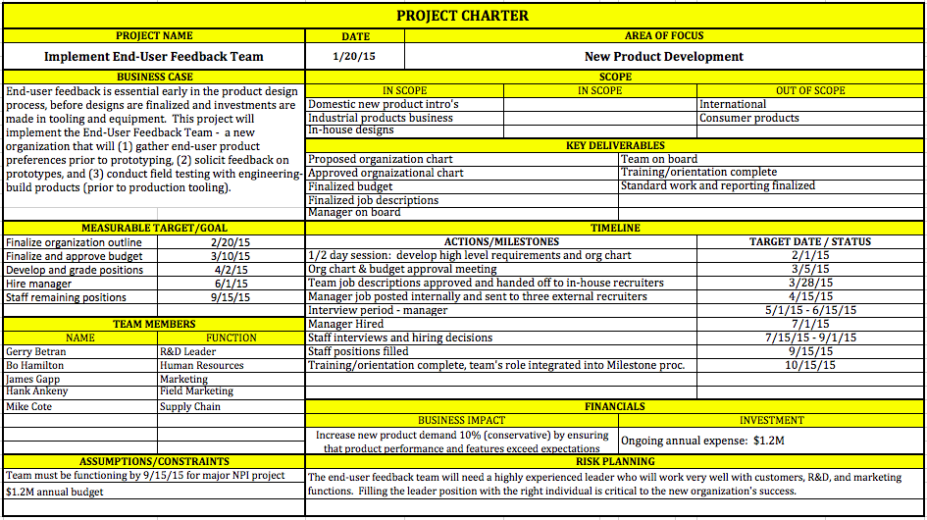
Project Charter

Slide 48
Project Scope
Once you have a good idea of what needs to be done, you need to track your scope as the project work is happening. Determining the project scope is setting goals for the project team and keep everybody on track.
Product scope means the features and functions of the product or service that you and your team are building.
Project scope is all of the work that needs to be done to make the product.
Scope creep means uncontrolled changes that cause the team to do extra work.

Slide 49
Project Scope
The five Scope Management processes that can be used in scope management are
Collecting the requirements to form a requirements document
Defining the Scope to form a Project Scope document
Creating a work breakdown structure
Consider change requests to modify project scope
Verify the scope iteratively by accepted deliverables

Slide 50
Project Scope Document
The Project Scope document is created by considering the following documents:
Project Charter
Requirements Document
Organizational Templates/Forms
When creating the project scope statement, you can perform the following actions
Stakeholder meetings → Output: Quantifiable goals
Product analysis
Alternatives Identification
Expert Judgement

Slide 51
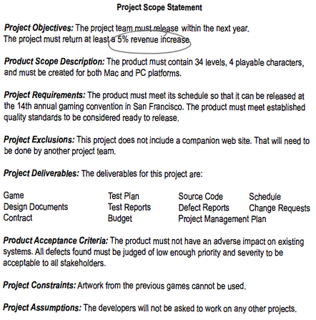
Project Scope Document
All the project objectives need to be measureable
Even though you probably can’t fit ALL of the requirements here, there should be enough detail to let you keep on planning and refer back to it late
This means looking for all the work the project DOESN’T include.
The deliverables listed here are EVERYTHING the project creates, including project management stuff.
Constraints are known limitations. Assumptions are things you think are true.

Slide 52
Wrap-up
Building good quality software requires the coordination of various planning, engineering and management activities
Structural software development was the main approach until last decade, nowadays object oriented development prevails.
We will cover both of the approaches in the lecture.
While beginning a software project, it is a common procedure to use project charters (or project offer or one-pager).
Analyzing and keeping up with scope is also very important which is carried out during the whole project.

Slide 53
Next Week
We will discuss software development lifecycle in detail and begin considering various classical lifecycle models!

